Slide 1
Python Programming
MULTI THREADING

Slide 2
Multithreading
Running several threads is similar to running several different programs concurrently, but with the following benefits −
Multiple threads within a process share the same data space with the main thread and can therefore share information or communicate with each other more easily than if they were separate processes.
Threads are sometimes called light-weight processes and they do not require much memory overhead; they are cheaper than processes.

Slide 3
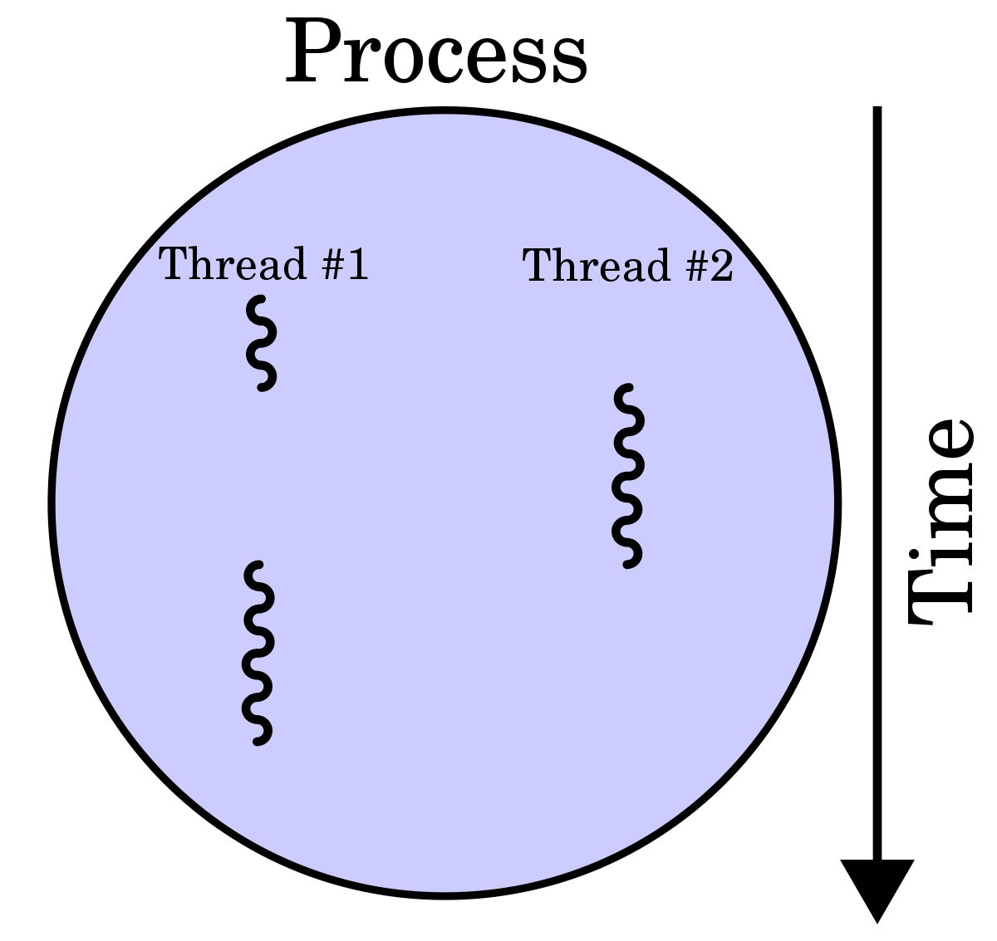

Slide 4
Types of Thread
User level Thread-It is implemented by user.
Kernel level Thread-It is implemented by os.
Race condition:
Two or more thread access same piece of data, inconsistent result may arise(because of order of data access).So we are going for lock system

Slide 5
Modules
Thread has two modules
_thread.
threading

Slide 6
_thread Modules
It provides following low level function for working threads.
1.allocate_lock-Creates new lock object of type lock type.Locks are initially unlocked
2.exit()-Forces thread to exit
3.get_ident()-Returns integer” thread identifier” of current thread
4.start_new_thread(func,args[,kwargs])-Executes a function func in a new thread .thread exits when function completely finished.

Slide 7
Functions inside lock object
1.lockobject_acquire()-Acquire the lock,waiting until lock is released by another thread if necessary
2.lockobject.release()-Releases a lock
3.lockobject.locked()-Returns lock status true-if locked else not

Slide 8
Creating a thread using _thread module
1)Define a new subclass of Thread class
2)Override __init__(self,args)to add additional arguments
3)Override run(self,args)method to implement what the thread should do when started.

Slide 9
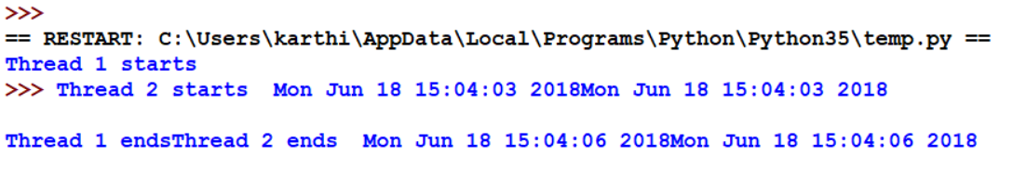
Without lock
import _thread
import time
def fun1():
print("Thread 1 starts",time.ctime())
time.sleep(3)
print("Thread 1 ends",time.ctime())
def fun2():
print("Thread 2 starts",time.ctime())
time.sleep(3)
print("Thread 2 ends",time.ctime())
t1=_thread.start_new_thread(fun1,())
t2=_thread.start_new_thread(fun2,())

Slide 10
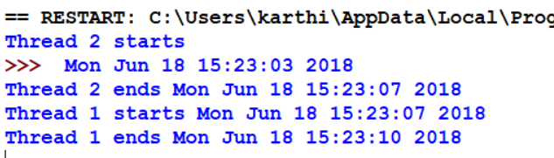
With Lock
import _thread
import time
def fun1(delay,lk):
lk.acquire()
print("Thread 1 starts",time.ctime())
time.sleep(delay)
print("Thread 1 ends",time.ctime())
lk.release()
def fun2(delay,lk):
lk.acquire()
print("Thread 2 starts",time.ctime())
time.sleep(delay)
print("Thread 2 ends",time.ctime())
lk.release()
lk=_thread.allocate_lock()
t1=_thread.start_new_thread(fun1,(3,lk))
t2=_thread.start_new_thread(fun2,(3,lk))

Slide 11
Synchornizing Thread
Locking mechanism that allows us to synchronize threads.
New lock is created by calling the lock method(returns new lock)
Acquire(blocking) of new lock object is used to force threads to run synchronously.
Release() of new lock object is used to release the lock when it is no longer required.
Syntax:
thread(grp,target,name,args=(),kwargs={})
Target –callable obj invoked by run
Name-thread name
Args-tuple/list arguments to be passed
Kwargs-dictionary argument

Slide 12
Threading object Methods
Start()- Begin thread execution.
Run()- Method defining thread functionality.
Join()- Suspend until started thread terminates blocks unless timeout is given
getName() – Return name of thread
setName()- set name of thread
isAlive()- Boolean flag indicating whether thread is still running
isDaemon()- Return Daemon flag of thread.
SetDaemon()-Used to set the thread as daemon thread.
Active_count-Return the number of threads currently running.
Enumerate()-display all the current running thread names.
Current_Thread()-display the current thread.

Slide 13

Sample Code
import threading
class mythread(threading.Thread):
def __init__(self,tid,tname,ct):
threading.Thread.__init__(self)
self.tid=tid
self.tname=tname
self.ct=ct
def run(self):
print(self.tname,self.tid,self.ct)
t1=mythread(1,'T1',1)
t1.start()
t1.join()
t2=mythread(2,'T2',2)
t2.start()
t2.join()

Slide 14

Sample Code
import threading
def fun1():
print("Thread function")
for i in range(2):
t=threading.Thread(target=fun1) --------→t=threading.Thread(target=fun1,args=(10,))
t.start()

Slide 15
Daemon Thread
Thread running at the background.
Main program waits until all other threads have completed their work

Slide 16
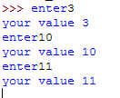
Code:
import threading
import time
def fun1():
print("starting 1")
print("exiting 1")
def fun2():
print("starting 2")
#time.sleep(5)
print("exiting2")
t1=threading.Thread(target=fun1,name='ND')
t2=threading.Thread(target=fun2,name='D')
t2.setDaemon(True)
t2.start()
t2.join()
t1.start()
t1.join()
print("t1",t1.isDaemon())
print("t2",t2.isDaemon())

Slide 17
Multithreaded Priority Queue
With the help of Queue module we can create a new queue object that can hold a specific number of items and threads. Queue module have following method which is given below. 1. get(): The get() removes and returns an item from the queue. 2.put(): The put adds item to a queue. 3.qsize() : The qsize() returns the number of items that are currently in the queue. 4.empty(): The empty( ) returns True if queue is empty; otherwise, False. 5.full(): the full() returns True if queue is full; otherwise, False.

